Slide 1






Project 2: Real-time Sentiment Analysis of YouTube Comments
Understanding Public Sentiment During Hari Raya
Group E

Slide 2




Team Members
DANIAL HARRIZ BIN MOHD ASINEH @MOHD ASNEH
TIEW CHUAN RONG
KOH SU XUAN
CHAI YU TONG

Slide 3
Introduction
Social media is a key platform for expressing feelings, especially during events like Hari Raya. YouTube is a major source of festive content and user engagement in Malaysia.
Background
Problem
Solution
Key takeaway
An automated real-time sentiment analysis pipeline using big data technologies to understand public sentiment during Hari Raya.
We're building a system to automatically understand what people are saying about Hari Raya on YouTube.
Manually analyzing thousands of comments is impractical.

Slide 4
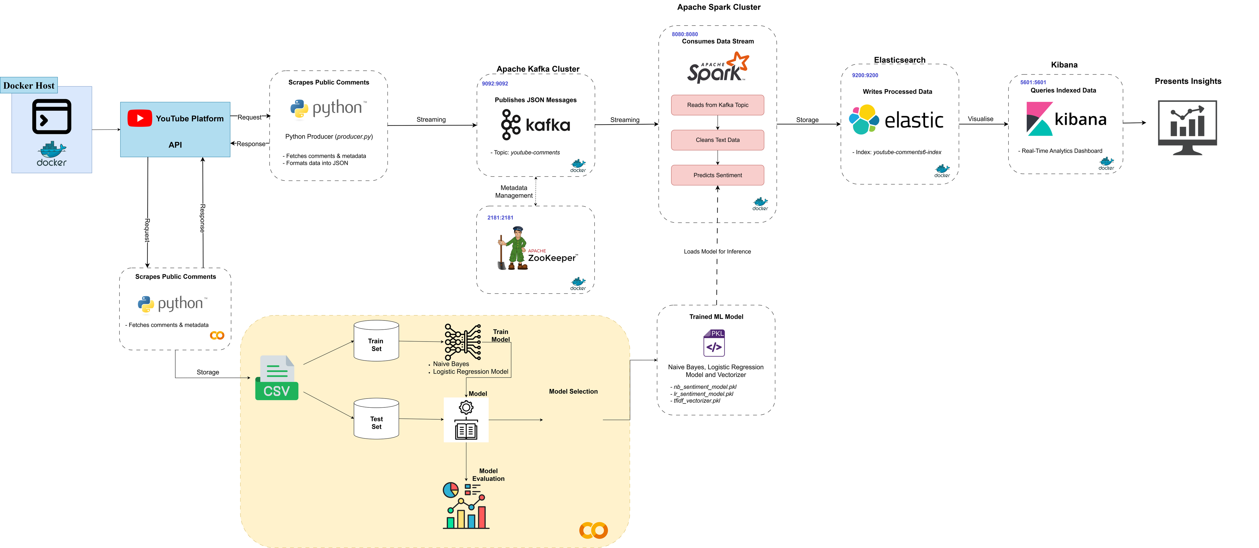
System Architecture Diagram

Slide 5
Model Training
Objective
Data Preprocessing
To train and evaluate machine learning models to classify YouTube comments into:
Positive
Negative
Neutral
The comments are cleaned (removed symbols, emojis, and lowercased)
TF-IDF vectorizer used to convert text to numeric features.
80/20 train split used.

Slide 6

Model Training
Models Used
Two models were trained:
Naive Bayes
Logistic Regression
Both the models were trained in Google Colab using scikit-learn

Slide 7
Model Training
Performance
Metric | Naive Bayes | Logistic Regression
Accuracy | 62% | 66%
F1-Score | 58% | 63%
Precision | 67% | 68%
Recall | 62% | 66%
✅ Logistic Regression outperformed Naive Bayes across all metrics.

Slide 8
System Architecture Diagram

Slide 9
Real-Time Streaming Architecture

Slide 10
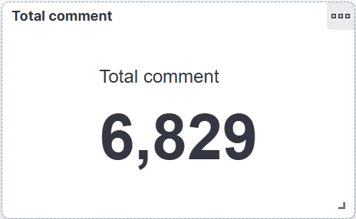
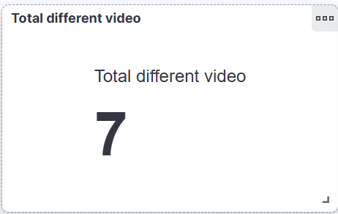
Visualization in Kibana
Total Comment
Total Different Video

Slide 11
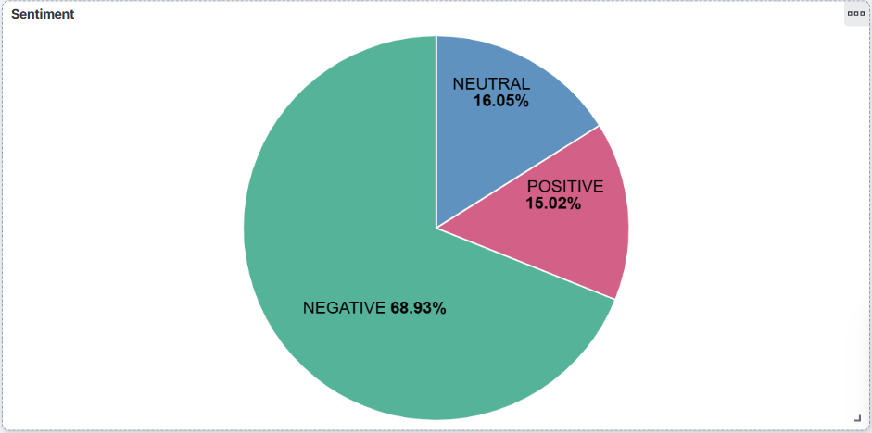
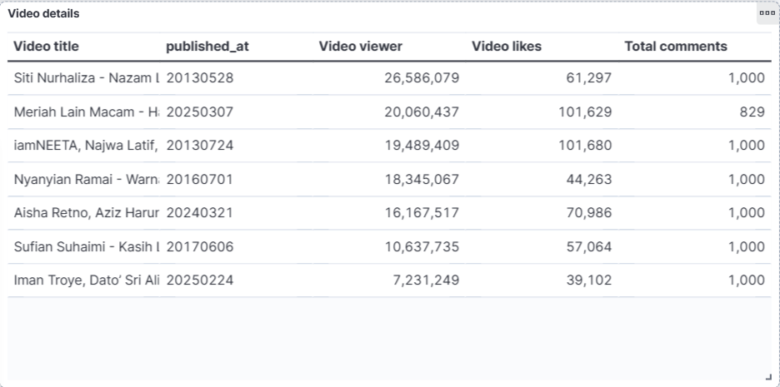
Visualization in Kibana
Sentiment Analysis on YouTube Video
Table of Video Details

Slide 12
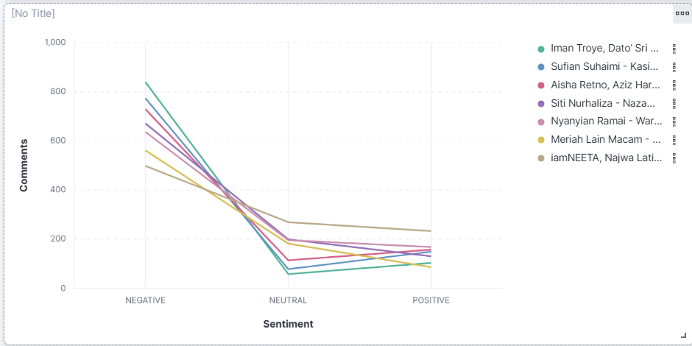
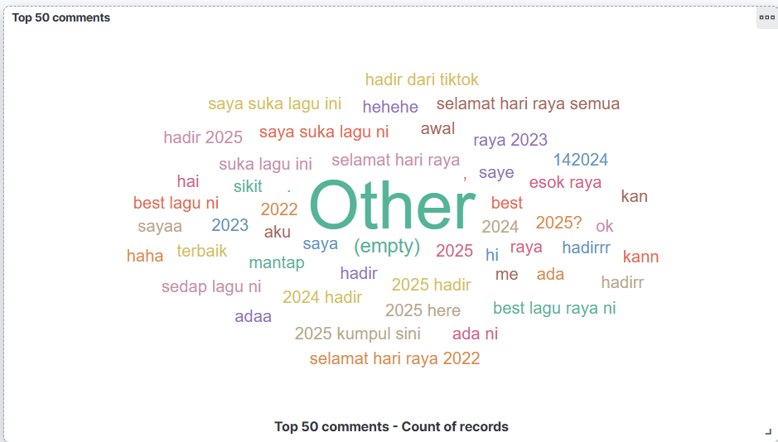
Visualization in Kibana
Sentiment Comparison between Different Video
Top 50 Comments Exist in the YouTube Video

Slide 13
Thank You

